Slide 1
NCODA’s 2025
Spring Forum Poster Deadlines
12/23/2024

Slide 2
Poster Timeline
Thursday, January, 23rd: Spring Forum registration opens
Monday, February, 3rd: Poster submission period begins
*Friday, February, 7th: Abstract(s) submissions deadline*
*Friday, February, 21st: Abstract feedback will be sent*
Friday, March, 7th: Poster(s) submissions deadline
Monday, March, 17th: Acceptance/denial status will be sent
Monday, March, 31st: Schedule for poster showcase will be sent
Wednesday-Friday, April, 23rd-25th: Spring Forum
*No abstracts are required for NCODA members or sponsors; however, abstracts are highly recommended if you are apart of one of our NCODA communities: technicians, nurses, and students.*

Slide 3

Poster Timeline – Calendar View
January 2025
Monday | Tuesday | Wednesday | Thursday | Friday
 |  | 1 | 2 | 3
 |  | New Years
6 | 7 | 8 | 9 | 10
 |  | OPTA |  | Nursing
13 | 14 | 15 | 16 | 17
20 | 21 | 22 | 23 | 24
Martin Luther King Jr Day |  |  | Registration for SF Opens
27 | 28 | 29 | 30 | 31
 | SETs
February 2025
Monday | Tuesday | Wednesday | Thursday | Friday
3 | 4 | 5 | 6 | 7
Open Poster Submission |  |  |  | *Abstract Deadline*
10 | 11 | 12 | 13 | 14
 |  | OPTA
17 | 18 | 19 | 20 | 21
George Washington's Birthday |  |  |  | *Abstract Feedback Returned*
24 | 25 | 26 | 27 | 28
 |  | SETs
March 2025
Monday | Tuesday | Wednesday | Thursday | Friday
3 | 4 | 5 | 6 | 7
 |  |  |  | Poster Submissions
10 | 11 | 12 | 13 | 14
 |  | OPTA
17 | 18 | 19 | 20 | 21
Poster Acceptance/Denial Emails |  |  |  | Poster Feedback Returned
24 | 25 | 26 | 27 | 28
 |  | SETs
31
Poster and Title Schedule Announced to Poster Participants
April 2025
Monday | Tuesday | Wednesday | Thursday | Friday
 | 1 | 2 | 3 | 4
7 | 8 | 9 | 10 | 11
 |  | OPTA
14 | 15 | 16 | 17 | 18
21 | 22 | 23 | 24 | 25
 |  | SPRING FORUM | SPRING FORUM | SPRING FORUM
28 | 29 | 30
 |  | SETs
*No abstracts are required for NCODA members or sponsors; however, abstracts are highly recommended if you are apart of one of our NCODA communities: technicians, nurses, and students.*

Slide 4
Abstract Requirements
(III) Hot Topic
(IV) Original Research
(V) Reviews
Service of Program/Background
Justification/Documentation
Adaptability
Significance
Introduction/Background
Research Question/Hypothesis
Study Design
Methods
Results
Conclusions
Introduction/Background
Methods
Results/Primary Study Points
Discussion
Other
Conclusion
(I) Case Reports
Introduction/Background
Case
Discussion
Conclusion
(II) Education/Training
Introduction/Background
Clinical Significance/Service
Justification/Documentation
Adaptability
Significance
NCODA Poster Abstract
2025 Spring Forum
Option
Name and Credentials
Email
Header
Title
Learning Objectives
Abstract [≤400 words]
Choose One Option Below:
    Case Reports
    Education/Training
    Hot Topic
    Original Research
    Reviews
References
Body
Your poster should focus on one of the options provided (e.g., III - Hot Topic). However, you have the flexibility to modify subtitles (e.g., Service of Program/Background) to better suit your poster. These subtitles are included to assist you in planning and organizing your poster effectively.

Slide 5

Abstract Example #1

Slide 6
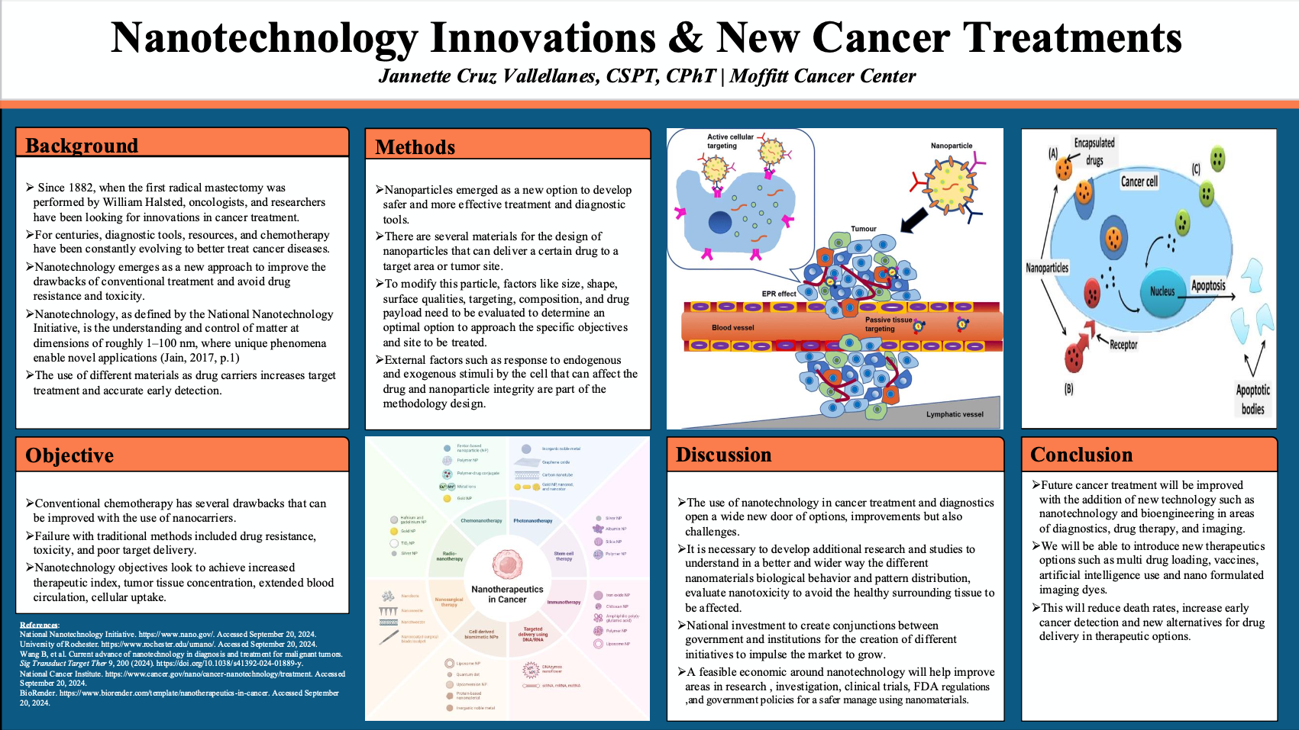
Poster Example #1

Slide 7
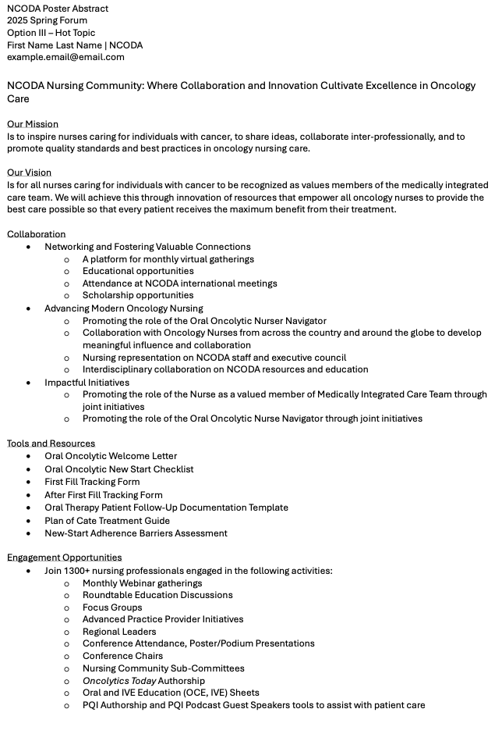
Abstract Example #2

Slide 8

Poster Example #2

Slide 9
Abstract & Poster Submissions
Abstract Submission(s)
  Complete your abstract and save it as an editable Word document
  Email the abstract with the subject line “2025 Spring Forum Abstract – Poster Title – First Name Last Name” to posterpresentations@ncoda.org AND CC: your designated committee lead by Fri, 7 Feb 25:
    Technicians: taryn.newsome@ncoda.org
    Nurses: mary.anderson@ncoda.org
    Students: cooper.bailey@ncoda.org
  You will receive feedback by Fri, 21 Feb 25
  After making the necessary edits, you can begin creating your poster, which must be submitted by Fri, 7 March 25
Poster Submission(s)
  You can submit your poster by filling out the survey “Spring Forum Poster Submission” found in this link
  Please submit your poster by Fri, 7 March 25
  If accepted, you will receive feedback on your poster by Fri, 21 March 25
  You will receive the poster schedule by Mon, 31 March 25
If you have any questions, please feel free to contact posterpresentations@ncoda.org. We eagerly await your submissions!
Notes:
Poster Submission Link: https://www.ncoda.org/poster-call/

Slide 10
Poster Reminders
Do not include brand names in the title
Avoid starting the title with “A”, “An”, or “The”
Spell out acronyms on their first use, e.g., over-the-counter (OTC)
If applicable, using callout boxes and arrows can effectively highlight key points
Format references according to the American Medical Association (AMA) style, including images
If there isn’t enough space for references or additional information you’d like to share, you may add a QR code to link it (please double-check to ensure it works)
Prepare a 3–4-minute elevator speech summarizing your poster for your presentation date
If you have any questions, please contact posterpresentations@ncoda.org
Use 10-14pt font
PowerPoint (official specs: 16:9 , 1920×1080, 300dpi) or PDF format are preferred
Avoid blurry graphics
Ensure consistency in font type and size throughout
Instead of typing directly in shapes, use text overlays on shapes to maintain consistent font size
Stick to serif or sans-serif font, and avoid difficult-to-read fonts
Make sure all elements are properly aligned, as misalignment is more noticeable on the TV screens

Slide 11
Poster Templates

Slide 12

Title
Name(s) | Name of Organization
Background
Methods
Discussion
Results / Conclusion
State the purpose of the research and summarize the current knowledge, the knowledge gap, and how the research project proposes to address the knowledge gap.
Describe the approach, including study design, participants, data collection, and analysis methods.
Interpret the results, highlighting their significance, implications, and potential limitations.
Summarize the key findings of the project or research, often with the support of data tables or figures.
REPLACE WITH GRAPHICS: (charts, graphs, diagrams, etc.) that effectively convey the data or concepts.
Reference(s)
Ensure all literature, data, prior work, graphics, etc., referenced in the presentation are properly cited.
Objective(s)
Disclosure
Identify the specific aims or research questions the project seeks to answer.
Disclose all financial or personal relationships that could influence the research or outcomes.

Slide 13
Title
Name(s) | Name of Organization
Background
Methods
Discussion
Results / Conclusion
State the purpose of the research and summarize the current knowledge, the knowledge gap, and how the research project proposes to address the knowledge gap.
Describe the approach, including study design, participants, data collection, and analysis methods.
Interpret the results, highlighting their significance, implications, and potential limitations.
Summarize the key findings of the project or research, often with the support of data tables or figures.
Objective(s)
REPLACE WITH GRAPHICS: (charts, graphs, diagrams, etc.) that effectively convey the data or concepts.
Reference(s)
Identify the specific aims or research questions the project seeks to answer.
Ensure all literature, data, prior work, graphics, etc., referenced in the presentation are properly cited.
Disclosure
Disclose all financial or personal relationships that could influence the research or outcomes.

Slide 14
Title
Name(s) | Name of Organization
Background
Methods
Discussion
Results / Conclusion
State the purpose of the research and summarize the current knowledge, the knowledge gap, and how the research project proposes to address the knowledge gap.
Describe the approach, including study design, participants, data collection, and analysis methods.
Interpret the results, highlighting their significance, implications, and potential limitations.
Summarize the key findings of the project or research, often with the support of data tables or figures.
Objective(s)
REPLACE WITH GRAPHICS: (charts, graphs, diagrams, etc.) that effectively convey the data or concepts.
Reference(s)
Identify the specific aims or research questions the project seeks to answer.
Ensure all literature, data, prior work, graphics, etc., referenced in the presentation are properly cited.
Disclosure
Disclose all financial or personal relationships that could influence the research or outcomes.

Slide 15
Title
Name(s) | Name of Organization
Background
Methods
Discussion
Results / Conclusion
State the purpose of the research and summarize the current knowledge, the knowledge gap, and how the research project proposes to address the knowledge gap.
Describe the approach, including study design, participants, data collection, and analysis methods.
Interpret the results, highlighting their significance, implications, and potential limitations.
Summarize the key findings of the project or research, often with the support of data tables or figures.
Objective(s)
REPLACE WITH GRAPHICS: (charts, graphs, diagrams, etc.) that effectively convey the data or concepts.
Identify the specific aims or research questions the project seeks to answer.
Reference(s)
Ensure all literature, data, prior work, graphics, etc., referenced in the presentation are properly cited.
Disclosure
Disclose all financial or personal relationships that could influence the research or outcomes.

Slide 16
Title
Name(s) | Name of Organization
Background
Methods
Discussion
Results / Conclusion
State the purpose of the research and summarize the current knowledge, the knowledge gap, and how the research project proposes to address the knowledge gap.
Describe the approach, including study design, participants, data collection, and analysis methods.
Interpret the results, highlighting their significance, implications, and potential limitations.
Summarize the key findings of the project or research, often with the support of data tables or figures.
Reference(s)
Ensure all literature, data, prior work, graphics, etc., referenced in the presentation are properly cited.
Objective(s)
REPLACE WITH GRAPHICS: (charts, graphs, diagrams, etc.) that effectively convey the data or concepts.
QR Code
Identify the specific aims or research questions the project seeks to answer.
REPLACE WITH QR CODE TO LINK SUPPLEMENTAL MATERIAL
Disclosure
Disclose all financial or personal relationships that could influence the research or outcomes.

